Slide 1


Memories App - using MERN stack
DISHEN MAKWANA
180470107035
G2

Slide 2


Topics
Project Objective, Context etc.
Application
Building the API’s using Express
Data-Base Models
Building the frontend User interface using ReactJS
Flow Diagram
Building the real-time update with socket.io
References & Project links

Slide 3
Objective
The objective of this project is to create a social media platform (i.e., Memories-App) in which people can create account, can add friends, can add new friends, can remove friends, can upload post as images or text with descriptions(captions), can view post of their friends, can like post of their friends, can maintain their profile,
You can also see their friend's profile on their profile page, also see their friend's profile on their profile page

Slide 4
Project Context
Memories-App is a real world simple social media application just like Instagram, Facebook, etc, but with less features.
This project is best for those who want to dive deeper into full stack using Nodejs, Express, React and MongoDB after learning HTML, CSS and JS.
Building a full stack application single-handedly is a tough task but learning and building such applications will help you master your skills.
Building this project will be a challenging task where you will get to learn and explore all about the MVC pattern, NoSQL Database (MongoDB) and much more.

Slide 5
Project Stages
We can divide the project based on the stack used:
ExpressJS: Framework for creating api’s that will connect Memories-App and Mongodb.
MongoDB: Using NoSQL Database.
NodeJs: Back-end JavaScript runtime environment, that is my application’s server.
Socket.IO: Building real-time update post in web
React: A JavaScript library for building User Interface. (Front-end)
Postman: A great tool for testing restful api’s.
MongoDB Atlas: To deploy, operate and scale MongoDB in the Cloud.

Slide 6
Application
You can use this among your friends or family and use it as a real world small scale social media application.

Slide 7
Building the API’s using Express
So, the first phase of the project is to build the API’s using the Express, NodeJs, MongoDB, and Postman.
Requirements:
Start building a server using express. Express.js, which is a lightweight framework for creating web servers, makes it easier to organize your application’s functionality with middleware's and routes.
Install Mongoose: Mongoose provides a straight-forward, schema-based solution to model your application data.
Install Nodemon: Nodemon is a tool that helps develop node.js based applications by automatically restarting the node application when file changes in the directory are detected.
Helmet: Helmet helps you secure your Express.js apps by setting various HTTP headers.
Morgan: HTTP request logger middleware for node.js.
Multer: Middleware for handling `multipart/form-data`.
After installing all the packages, our project folder must consist of index.js files along with package.json, package-lock.json and node modules.

Slide 8
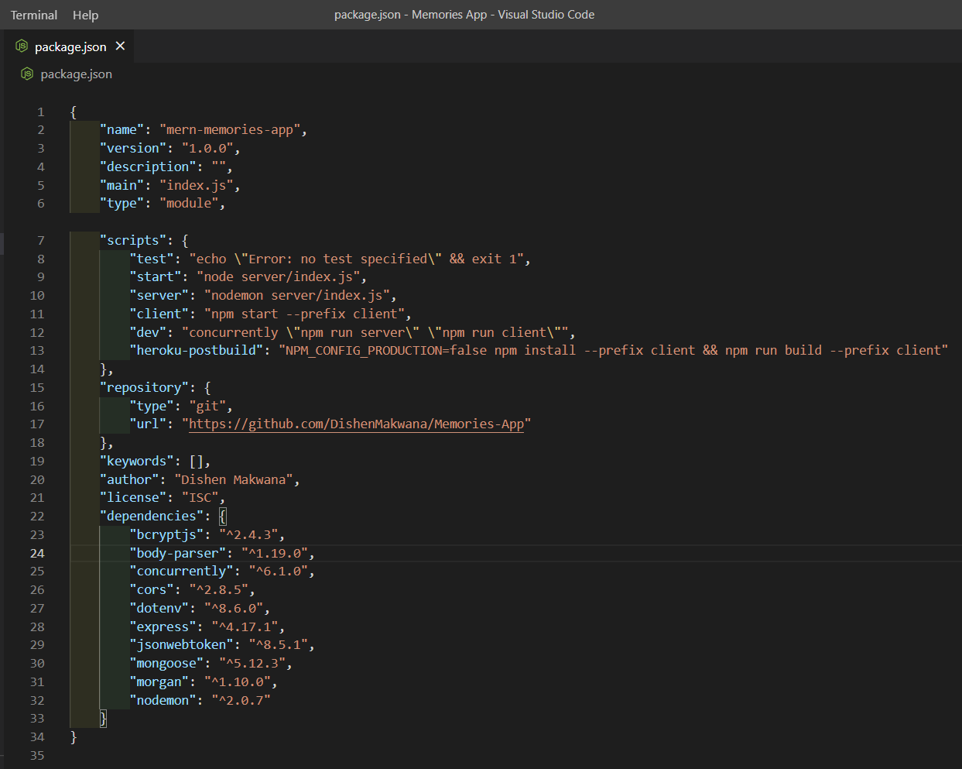
On Exploring package.json file you will find all your packages installed in dependencies as shown below.
Now we need to create all the models that will connect our application to our database which is MongoDB Atlas cloud.

Slide 9
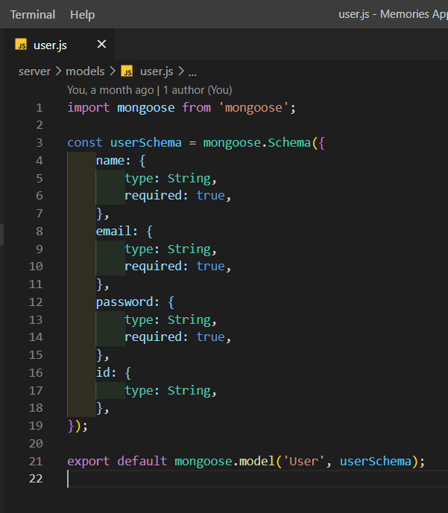
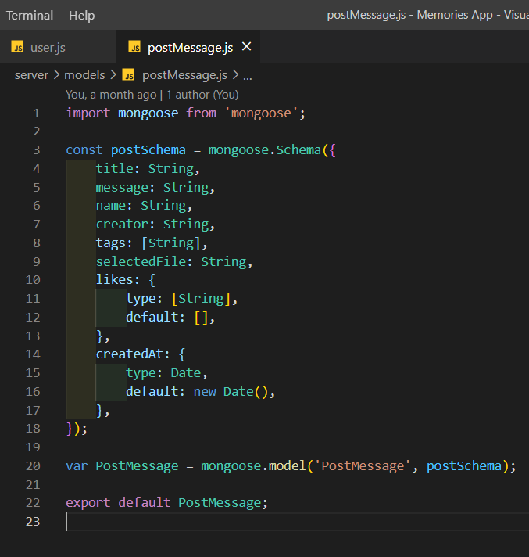
DataBase Models
Users.js
postMessage.js

Slide 10
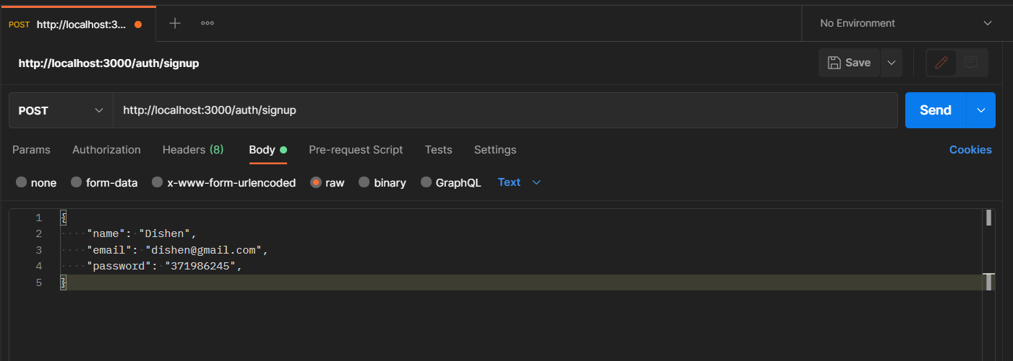
API Request threw Postman app
After doing so we need to create routes of all schema to our database.

Slide 11

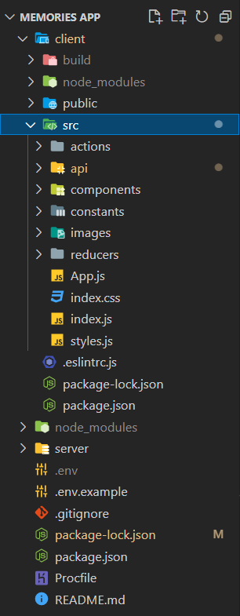
Building the frontend User interface using ReactJS
In order to use React in production, you need NPM and Node.js installed. Now we need to create our app using:- npx create-react-app chat-react.
Our folder chat-react will be created and will look like this:
We will start developing the application by creating components of our Memories-App, so we can reuse them in any part of our application.

Slide 12
Header
Feed: This will be the main component which is the parent of two components, that are share and post.
This will fetch all the timeline posts from the database with the help of apis.
Post: This component will be under the feed component where the user can see his own posts which he has posted and his friend’s posts.
This component will fetch data from the post api and display it to the user. This will allow user’s followers to like the post or to dislike the post.
Share: This component will allow users to share the post along with post description and post image.

Slide 13
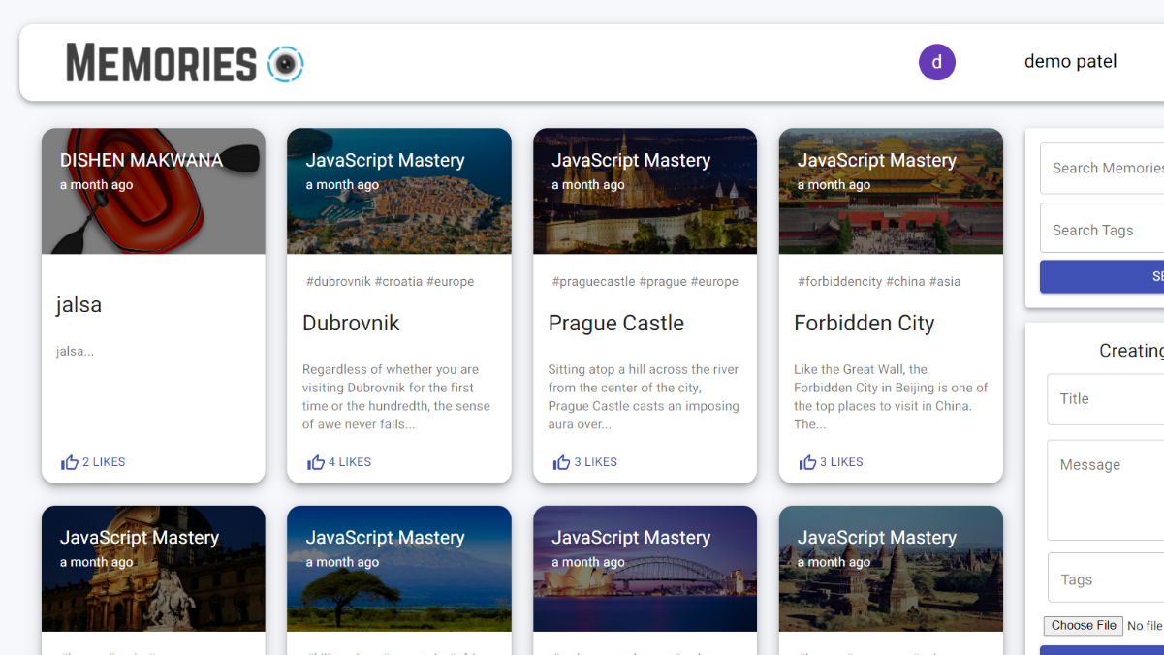

Slide 14
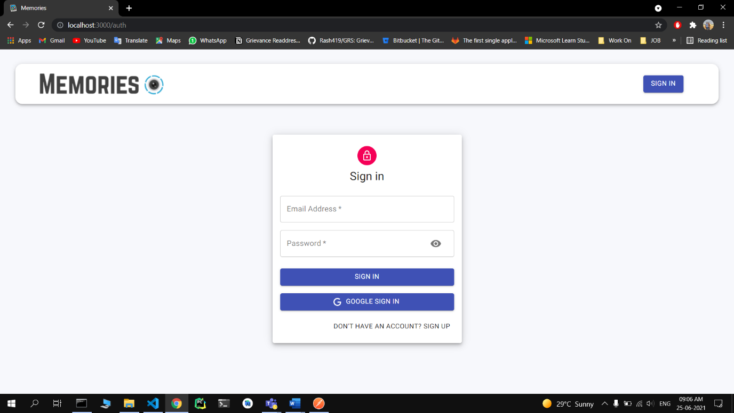
Login Page

Slide 15
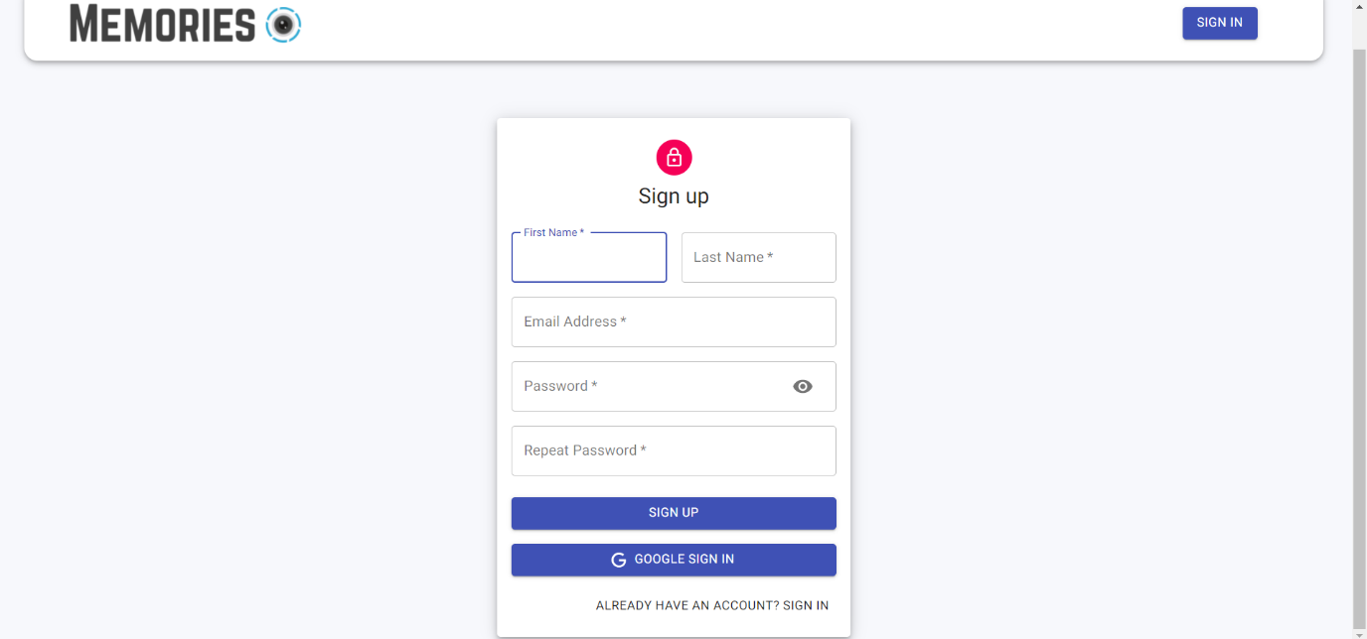
Registration Page

Slide 16
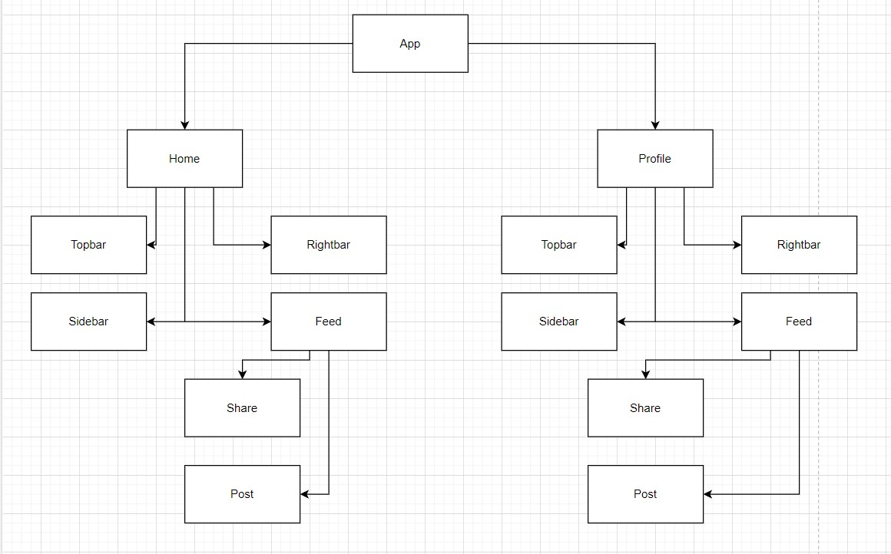
Flow Chart

Slide 17
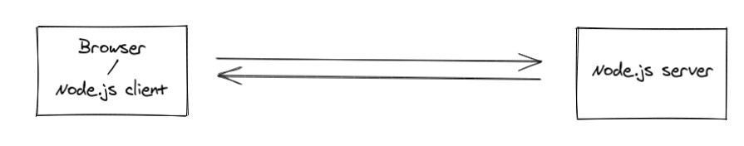
Building the real-time update with socket.io
Socket.IO enables real-time, bidirectional and event-based communication. It works on every platform, browser or device, focusing equally on reliability and speed.
The client will try to establish a WebSocket connection if possible and will fall back on HTTP long polling if not.
WebSocket is a communication protocol which provides a full-duplex and low-latency channel between the server and the browser. More information can be found here.
So, in the best-case scenario, provided that:
• the browser supports WebSocket (97% of all browsers in 2020)
• there is no element (proxy, firewall, …) preventing WebSocket connections between the client and the server you can consider the Socket.IO client as a “slight” wrapper around the WebSocket API.

Slide 18
References & Project links
GitHub - https://github.com/DishenMakwana/Memories-App
Live - https://memories-app-dm.netlify.app/ & https://memories-app-dm.herokuapp.com/
https://nodejs.org/en/
https://expressjs.com/
https://www.w3schools.com/
https://reactjs.org/
https://socket.io/
https://developer.mozilla.org/en-US/

Slide 19
Thanks
DISHEN MAKWANA
180470107035

